Slide 1


Read Write Inc.
Teaching Phonics at Oakwood
September 2023
1

Slide 2
Why Read Write Inc
Phonics?
Tried and tested over many years
A systematic, structured and evolving programme
Regular built-in assessment to check progress
A one-to-one support programme
Early success in reading
Training and ongoing support for staff
“When children can’t read there is low self esteem. We want them to be reading with confidence, to be able to read quite sophisticated texts at an early age.”
Ruth Miskin – former headteacher and creator of Read Write Inc.
2
Notes:
As a school we want to ensure that all our children are successful readers.
We use the RWI programme because it is very rigorous and with its focus on assessment and differentiation it helps children of varying abilities to make good progress:
• It has been tried and tested over and over again in schools across the country.
• It is systematic, well structured and therefore results in children rapidly learning sounds & blending.
•There is a built in system to regularly assess progress being made by each child.
•There is a 1 to 1 support programme to prevent children falling behind
•Training & development for staff is an on-going part of the programme.
•It is built around some central beliefs including the need for a rapid pace of learning, praise and encouragement for children and a passion for reading.

Slide 3
Who is it for?
Children from 4 years who are starting school – Read Write Inc. is a ‘start-up’ reading programme
3
Notes:
Read Write Inc. lasts just over two years for most children, if they start the programme in Nursery.
It also supports children who join the programme at a later point or who are experiencing differing learning difficulties.

Slide 4
How does it work?
Your child will:
Learn 44 sounds and corresponding letters and letter groups
Learn how to read words by blending
Read lots of specially written books featuring all the words they have learned to sound out and blend
This is known as decoding
4
Notes:
Learn 44 sounds and corresponding letters and letter groups
Learn how to read words by blending
Read the carefully written books featuring all the words they have learned to sound out and blend

Slide 5
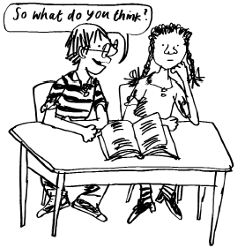
How does it work?
To develop their comprehension, your child will:
Talk a lot about what they have read to show their own understanding
Listen to and discuss other ideas to deepen their knowledge of the text
5
Notes:
Speaking & Listening elements of literacy are built in to RWI from the very beginning through lots of talking and partner work.
Partner Work – children working with their talk partner is a fundamental part of the programme. Research has shown that where a child can teach another child, something they are learning themselves, it helps to cement that learning in their mind in the most powerful way.

Slide 6
Phonemes
All words are made up of sounds
In English there are 44 sounds (phonemes)
6
Notes:
Say a short sentence in Fred Talk (use very pure sounds – no ‘uh’) to illustrate e.g. say “s_o i_f I t_al_k i_n th_i_s w_ay, y_ou w_ill h_ear ea_ch s_ou_n_d i_n m_y w_or_d_s!
Explain we use pure sounds (‘m’ not’ muh’, ’s’ not ‘suh’, etc.) so that your child will be able to blend the sounds into words more easily. Say that in school we use a puppet called Fred who can do this beautifully! We call talking like this, Fred Talk. Hold up a Fred!

Slide 7
Graphemes
A grapheme is a sound written down.
In English there are more than 150 graphemes to represent 44 sounds using our 26 alphabet letters.
You
7
Notes:
In English we have more 150 ways to represent 44 sounds using our 26 letters of the alphabet
So groups of letters are used as well as single letters – these are called graphemes.
We will teach the 100 most commonly used graphemes for the 44 sounds. But we will teach them systematically and very thoroughly.

Slide 8
‘ai’ sound
train
day
cake
sleigh
straight
baby
rein
reign
8

Slide 9
Learning the code
We start off teaching your child a simple version of the code
9
Notes:
This simple chart shows just one grapheme per sound.
We divide them into set 1 and set 2 & we systematically teach set 1 & blending and then set 2 and then we go on to the full chart which includes set 3.
Don’t go into detail – say this is just to explain the basics.
Quickly ‘show-off’ by whizzing through the chart in pure sounds!

Slide 10
Consonants: stretchy
f | l | m | n | r | s | v | z | sh | th | ng
 |  |  |  |  |  |  |  |  |  | nk
Consonants: bouncy
b | c | d | g | h | j | p | qu | t | w | x | y | ch
 | k
Vowels: bouncy
Vowels: stretchy
a | e | i | o | u | ay | ee | igh | ow
oo | oo | ar | or | air | ir | ou | oy
Set 1 sounds
Set 2 sounds
10
Notes:
There is an audio guide on the Ruth Miskin Literacy website which gives guidance on pure pronunciation (already gone out as a weblink and a letter).
Go through these sounds quickly with parents. Using My Turn/Your Turn, try some of these sounds. Explain meaning of ‘stretchy’ and ‘bouncy’ sounds.
Common to confuse letters which look alike e.g. d/b, i/j, n/u.
Don’t worry if your child has difficulty pronouncing some sounds. Many children have a few sounds they find difficult to say. They can easily learn to read, as long as we know what sound the child is trying to say. You can help your child by encouraging him or her to look at your mouth when you say the sound.
We aim to get rid of ‘ugh’ to help blending. A slight ‘ugh’ cannot be helped when saying the sounds ‘b’, ‘d’, ‘g’, ‘j’, ‘w’ and ‘y’. Listen to the sound at the end of the word.
Please don’t use the letter names at this stage – just pure sounds
Make it fun! Set 1 then long vowels in set 2.

Slide 11

Reading
Involves two skills:-
-being able to look at the letters and say the corresponding
sounds
-being able to blend the sounds and hear the word
‘Fred’ can only talk in pure sounds... (he can only say c_a_t, he can’t say cat) so he helps the children to blend sounds to make a word. We call this Fred Talk.
Lots of oral blending is key!
Once a child can recognise the first 5 letter sounds (m, a, s, d, t) and they can blend sounds, they should be able to read sat, Sam, mat, mad, sad, at, as
Child is able to read more complex words as s/he progresses through the programme.
11
Notes:
Hold up Fred! Say you too can have a Fred at home – use one like this or any stuffed toy.

Slide 12
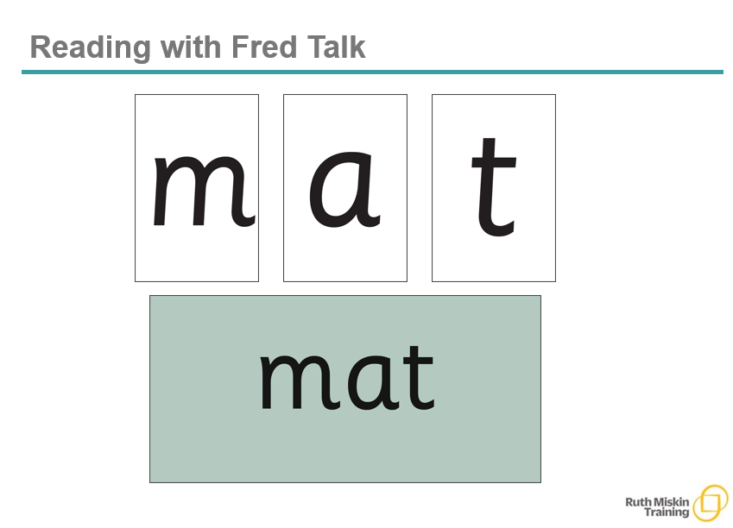
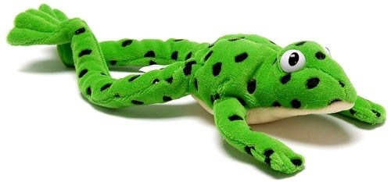

Slide 13
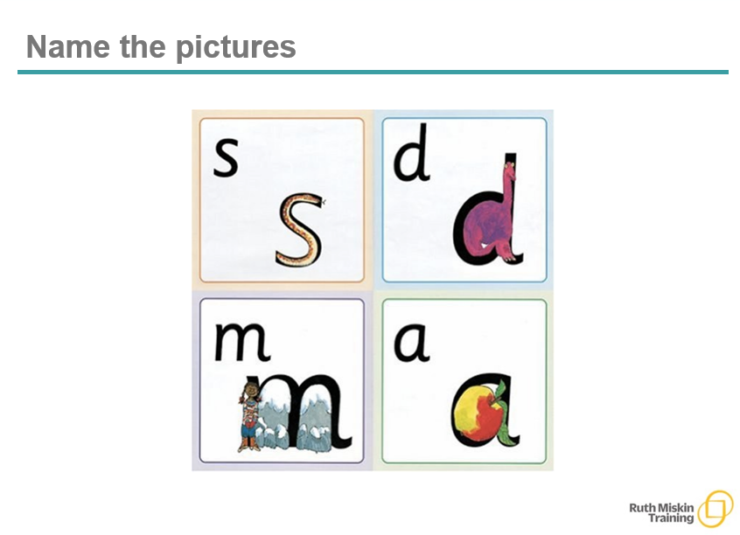

Slide 14
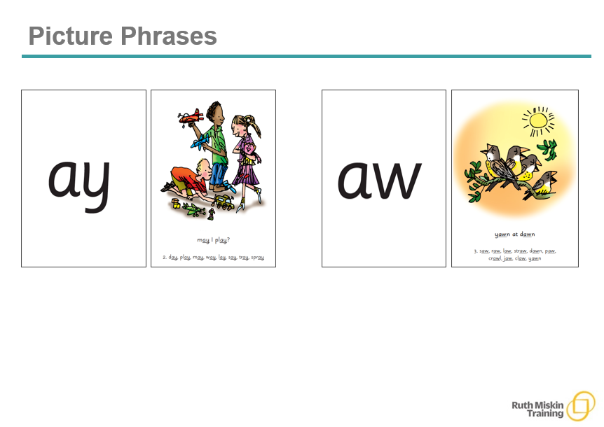

Slide 15
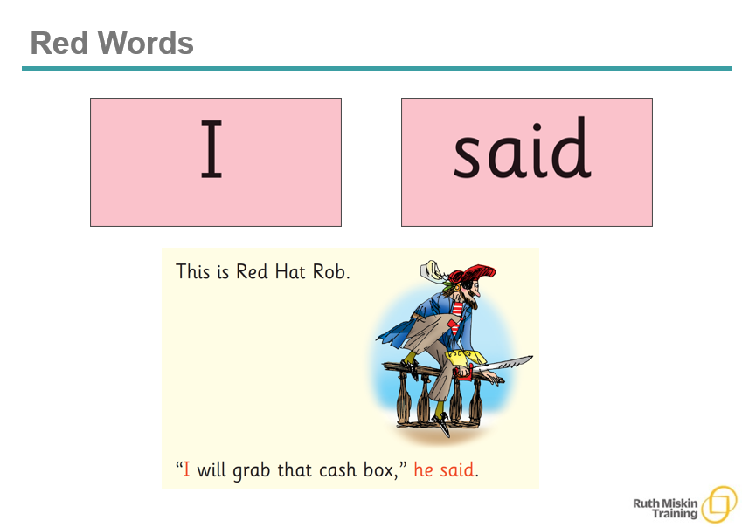

Slide 16
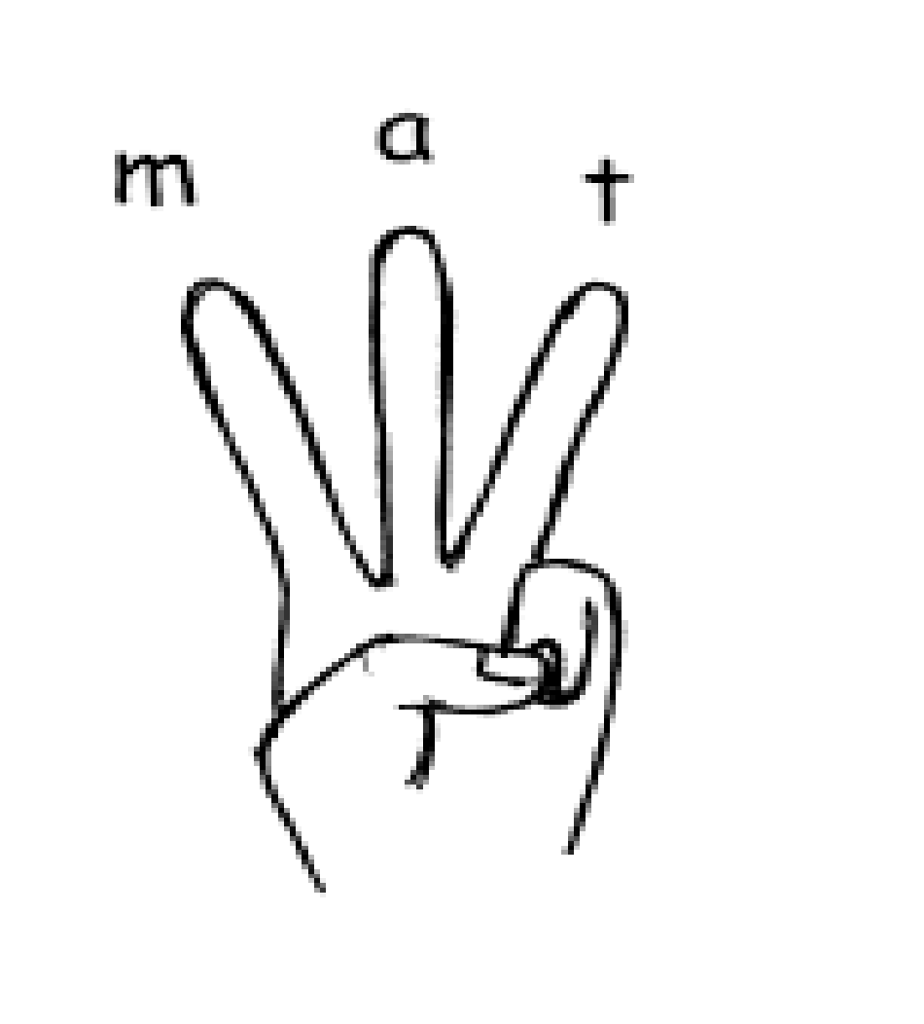
Spelling...
We use Fred to help the children to learn to spell as well!
They convert a whole word they hear into sounds.
In spelling, we call them ‘Fred Fingers’. We tell them how many Fred Fingers they need, they squeeze the sounds they hear in the word on their fingers and then write the word down.
16
Notes:
Show how to use fingers to spell some of the words you have just blended. Use My Turn Your Turn with the parents – say “show me three fingers – the word is dog.” (or shop or wish or any 3 sound word) “Now put your sounds on your fingers!”
The reversibilty principle of decoding for reading and encoding for writing.

Slide 17
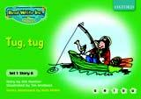
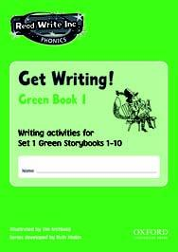

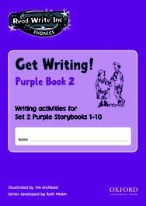

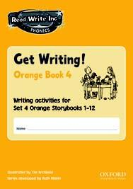

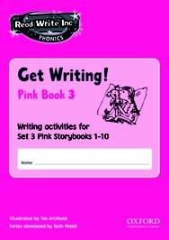
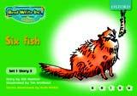



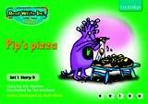
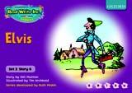


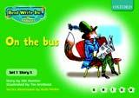
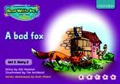


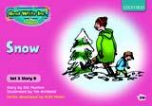
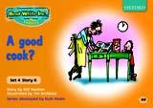
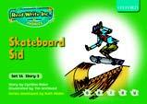


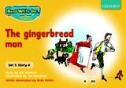
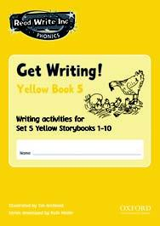
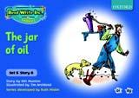
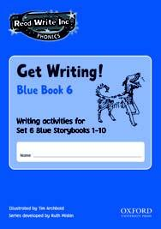
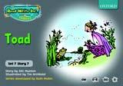
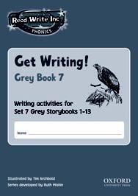
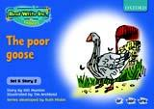

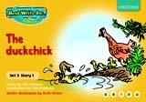


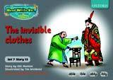
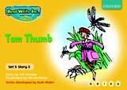
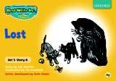
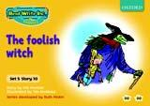


Storybooks and Get Writing Books
17
Notes:
Every day, your child will read and write the words that contain the sounds and graphemes they have learned so far, using lively, fun phonic storybooks and a Get Writing book. Hold up some Storybooks and Get Writing Books.
-Hold up picture books – as part of our literacy programme in YR we have been sending home some picture books without words. This provides a really valuable and hopefully enjoyable time to spend with your child, developing reading skills such as creating narrative, predicting what will happen next and talking about the setting and the feelings of characters etc.

Slide 18
Reading Books
Set 1 sounds and blending
Storybooks 10 x Green 10 x Purple 5 x Pink
Set 1 & 2 sounds
Storybooks 5 x Pink 12 x Orange
Storybooks 10 x Yellow
Storybooks 5 x Blue:
Set 1, 2, 3 sounds
Storybooks 5 x Blue 13 x Grey:
Ditties…. -
18
Notes:
Once children are confident with the set 1 sounds and are beginning to blend independently they will begin to bring home simple decodable books and ditty sheets like the ditties they will be reading in school. Ditties are simple phrases to build the children’s confidence.
Show ditty book– They are not the most scintillating texts to read (refer to the awe and wonder moment when you hear your child reading text perhaps for the first time!) They are good at helping them to get them feeling confident about themselves as readers.
They will then progress onto the Green, purple then pink books.
You can see the progression in book colours on this slide. (explain link between sounds and books)
Children do not necessarily read all the books. The focus is on making rapid progress.
Adam….

Slide 19
The Three Reads
Reading first to practise decoding
Reading a second time to ensure they understand the text
Reading a third time to develop a story-telling voice
19
Notes:
-Over three days, the children encounter each text three times, working with their reading partner.
-They read it first to practice decoding the text
-The second day they focus on comprehension, often with the teacher modelling the process.
-The final reading is to bring the text to life by adding intonation or story voice.

Slide 20
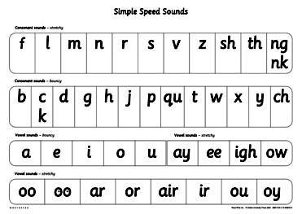
So how can you help your child?
By knowing the 44 sounds
They can practise the speed sounds with the sheets which are sent home daily and/or the Speed Sound Book
By using Fred Talk sometimes at home with everyday words like these:
back, head, tum, leg, hand, foot, knee
coat, hat, scarf, zip, sock, glove
20
Notes:
(Kerry)
-Please spend a little time going through the sound on the sound sheets when they come home as this extra practice is so valuable in helping children to commit the sounds to their long term memory.
-Please help your child to practice their Fred Talking - - - you will be hearing a lot about Fred The Frog in the weeks and months to come… the children get quite emotionally attached … my daughter has actually asked for one for Christmas!
-You have all had a go at using your Fred Fingers and if you can regularly practice this with your child it will be of great help.
Kerry…..

Slide 21
And...
By knowing how to blend using Fred Talk for reading m_a_t
By knowing how to do Fred Fingers for spelling
21
Notes:
Show sound sheet – Children have already started bringing sound sheets home. We would be very grateful if you can use these sheets to go over the sound they have just learned in school. The child should look at the grapheme on the sheet and say the sound. You can ask your child about the pictures underneath (explain moving from sound/word to just saying the word). Practise saying the phrase as they write the grapheme in the middle box and then say the sound as they write the grapheme in the bottom box.
The sheet also gives you the chance to practice your writing skills, holding the pencil using a tripod grip (demonstrate) forming the letters correctly etc.
Give a couple of examples e.g. Where is your c_oa_t? Time for b_e_d! Make sure your child can tell you what the word is.
Stress only single syllable words (no Fred Talking multi-syllabic words) and only the last word in a sentence or it gets very silly! E.g. P_u_t o_n y_our b_l_ue c_oa_t (you’ll never get out!).

Slide 22
And...
By reading to your child lots of lovely stories that are at a higher level than your child can read yet and asking lots of questions!
Use these prompts at the end of each page or paragraph:
What is that character thinking?
What is happening in
this
part of the story?
What do you think
will happen next?
What is that character saying?
What do you think that
character is feeling now?
22
Notes:
(Kerry)
Sharing books with your child is of course a critical part of your child’s journey to becoming a successful reader by developing their comprehension skills.
The other thing of course is that it opens their minds to the joy of reading, something of course I know we would all want for all of our children.
Adam…

Slide 23
And...
By talking to your child as much as possible and ‘feeding’ them new and different words:
By enriching conversations through description:
“Look at that rain. It looks like little diamonds hitting the window pane!”
“Let’s eat our lunch now.”
“Let’s scoff our lunch now.”
“Let’s munch our lunch now.”
“Wow that’s a big dog!”
“Wow that’s an enormous dog!”
“Wow that’s a massive dog!”
23
Notes:
A rich vocabulary is essential for high levels of comprehension.
The more words your child has in his/her head when they come to school, the quicker their understanding (comprehension) when they learn to read (decode) those words.
If they encounter a rich vocabulary when talking to adults and in their reading of course, they will begin to use it in their writing too.
As part of the RWI programme we focus on helping children to develop the depth of their vocabulary by encouraging them to use more interesting and powerful alternatives.

Slide 24
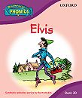

And...
By having a look at the Read Write Inc At Home pages on the web for tips and resources for supporting your child at home:
www.ruthmiskinliteracy.com
or
www.oup.com (RWI resources are published by Oxford University Press)
24
Notes:
(Adam)
The two websites here give very useful guidance for teachers and parents alike as well as resources if you want to access or purchase them.
This term we will be adding lots of resources and guidance to our website and we will alert you to it when its there. We will also be holding surgeries for parents to come in and chat to us if you have any questions or want any help and we will let you know in the green newsletter.

Slide 25

Ustadah Sheerin
25

